Slide 1
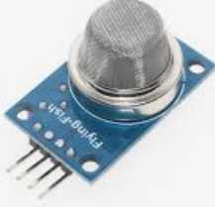
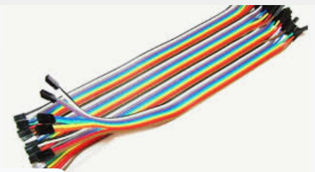
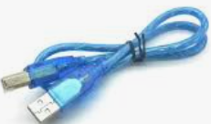
AIR QUALITY MEASUREMENT USING MQ-135 GAS SENSOR AND ARDUINO
Components to be used:
MQ-135 GAS SENSOR
Arduino uno
USB Cable
Breadboard
Connecting wires

Slide 2
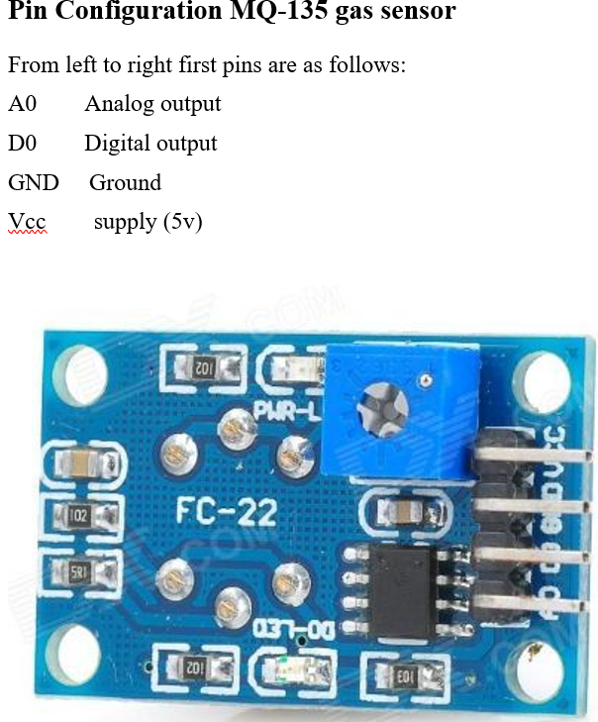

Slide 3
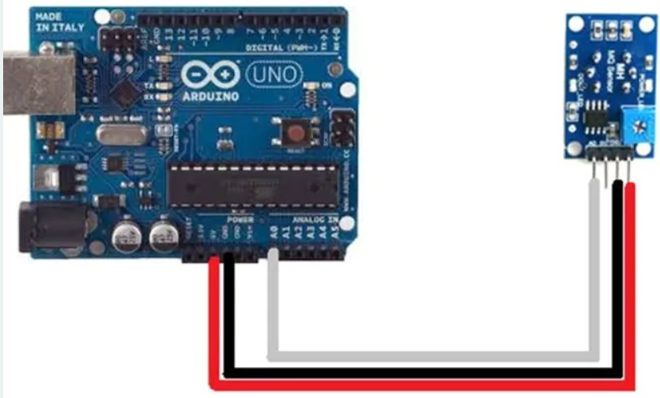
CIRCUIT DIAGRAM

Slide 4
Experiment procedures
1.Connect the circuit as shown by the above circuit diagram
2.Connect microcontroller into your PC
3.Type the Program CODE into computer connected on Arduino
4.Compile and download the program into microcontroller
6. Record the measured distance

Slide 5
LAB Session
Let connect the circuit diagram.

